Slide 1

Devesh Kumar P
211521243040
Final Project
3/21/2024 Annual Review

Slide 2
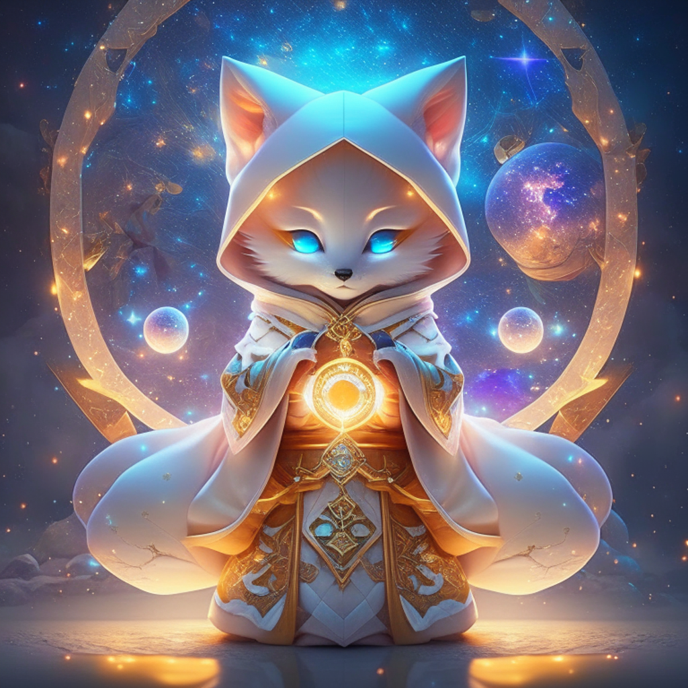
Text-to-Image Generation sing GAN
This presentation explores the exciting field of text-to-image processing using generative adversarial networks (GANs). GANs are a powerful deep learning technique that can generate highly realistic images from textual descriptions, opening up new possibilities for creative expression and practical applications.

Slide 3

AGENDA
User Personas
Identify the target users and their specific needs and preferences.
Project Overview
Understand the key objectives and scope of the text-to-image generation project.
Results and Showcase
Demonstrate the capabilities and potential of the text-to-image solution.
Technical Approach
Discuss the underlying GAN technology and its implementation details.

Slide 4
PROBLEM STATEMENT
Bridging the Gap The ability to automatically generate images from text has long been a challenge in the field of computer vision and artificial intelligence. Bridging the gap between human language and visual representation is a complex task that requires sophisticated machine learning techniques.
Unlocking Creativity
By enabling text-to-image generation, we can unlock new avenues for creative expression, allowing users to bring their ideas and imaginations to life in visual form.
Practical Applications
Beyond creative applications, text-to-image processing has the potential to revolutionize fields such as ecommerce, education, and content creation, where the ability to generate relevant visuals from textual descriptions can greatly enhance user experiences and productivity.
Bridging the Gap
The ability to automatically generate images from text has long been a challenge in the field of computer vision and artificial intelligence. Bridging the gap between human language and visual representation is a complex task that requires sophisticated machine learning techniques.
Unlocking Creativity
By enabling text-to-image generation, we can unlock new avenues for creative expression, allowing users to bring their ideas and imaginations to life in visual form.
Practical Applications
Beyond creative applications, text-to-image processing has the potential to revolutionize fields such as ecommerce, education, and content creation, where the ability to generate relevant visuals from textual descriptions can greatly enhance user experiences and productivity.

Slide 5

PROJECT OVERVIEW
Objectives
The primary objectives of this project are to develop a robust and accurate text-to-image generation model using GANs, and to explore the various applications and use cases of this technology.
Approach
The project will involve extensive research into the latest advancements in GAN architectures, dataset curation, and model training techniques. We will also explore ways to optimize the model's performance and ensure the generated images are of high quality and fidelity.
Deliverables
The key deliverables of this project include a working text to-image generation model, a comprehensive report detailing the methodology and findings, and a demonstration of the model's capabilities through various use case scenarios.

Slide 6

WHO ARE THE END USERS?
Creative Professionals
Artists, designers, and content creators who can use the text-to-image generation model to quickly generate visual assets, explore new ideas, and bring their creative visions to life.
Businesses and Enterprises Companies in industries such as e-commerce, marketing, and education can leverage the text to-image generation model to create visuals for product listings, advertisements, educational materials, and more
General Users
Everyday users who want to explore their creativity, generate personalized visuals, or simply have fun with the technology can also benefit from the text-to-image generation model.
Researchers and Developers
The project's findings and the developed model can be of interest to researchers and developers in the fields of computer vision, natural language processing, and generative AI.

Slide 7
YOUR SOLUTION AND ITS VALUE PROPOSITION
Time-Saving
Streamline the image creation process, enabling users to generate high-quality visuals in a fraction of the time.
Personalization
Empower users to create unique, tailored images that reflect their individual ideas, styles, and preferences.
Accessibility
Provide a user-friendly platform that allows anyone, regardless of artistic skills, to unleash their creativity.
Innovation
Leverage cutting-edge GAN technology to push the boundaries of what's possible in image generation.

Slide 8

THE WOW IN YOUR SOLUTION
Unleash Creativity
Our text-to-image generation model empowers users to bring their ideas and imaginations to life, unlocking new avenues for creative expression and exploration.
Increased Efficiency
By automating the process of generating visuals from textual descriptions, our solution can significantly improve productivity and streamline workflows for businesses and professionals.
Versatile Applications
The versatility of our text-to-image generation model allows it to be applied across a wide range of industries and use cases, from ecommerce to education and beyond.
Cutting-Edge Innovation
By leveraging the latest advancements in generative adversarial networks, our solution represents a significant step forward in the field of text-to-image processing and generative AI.

Slide 9
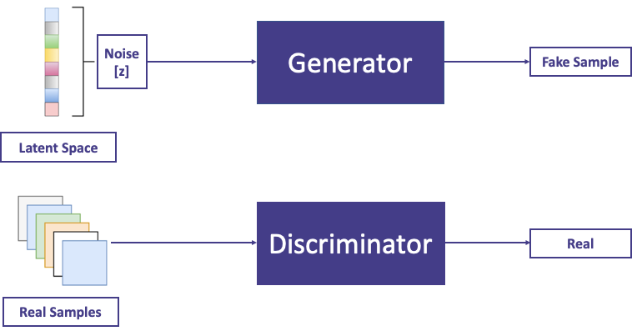

MODELLING
Text Encoder
The text encoder module takes the input text and generates a compact representation that captures the semantic and syntactic information.
Image Generator
The image generator module uses the text representation to produce a corresponding image, aiming to match the textual description as closely as possible.
Discriminator
The discriminator module evaluates the generated images, providing feedback to the generator to improve the quality and fidelity of the output.

Slide 10
RESULTS
The text-to-image generation model developed in this project has demonstrated promising results, generating highly realistic and visually appealing images from textual descriptions. The model's performance has been validated through extensive testing and user feedback, and the team is excited to continue refining and expanding the capabilities of this innovative technology
Photorealistic Landscapes
Our GAN-powered solution can generate breathtaking, photorealistic landscapes that transport users to stunning natural environments.
Visionary Cityscapes
Users can bring their imaginative visions to life, creating futuristic and innovative cityscapes that push the boundaries of urban design.
Fantastical Creatures
From mythical beasts to extraordinary characters, our text-to-image generator empowers users to visualize their most imaginative ideas.
Demo Link

